Slide 1
Unified Loss Optimization for Multi-Relational Recommendation
Alberto Ricchiuti
Department of Computer Science, University of Bari — Bari, Italy
Course: Semantics in Intelligent Information Access
Email: a.ricchiuti20@studenti.uniba.it

Slide 2
Motivation
Modern recommenders operate over multi‑relational graphs with rich semantics.
Many pipelines optimize separate objectives for knowledge‑graph completion and user–item ranking.
Fragmented training can dilute specialization and complicate model comparison and attribution.

Slide 3
Contributions
Q: What happens when KG embedding quality, recommendation accuracy, and regularization are trained under a single objective?
Built a unified framework in RecBole coupling CompGCN and TransE under one loss.
Provided a rigorous theoretical walk‑through and reproducible PyTorch blueprint.
Released a harmonized evaluation protocol and ablations on composition operators.

Slide 4
Background: TransE
Translational scoring: minimize ‖E(h) + R(r) − E(t)‖₂ for true triples; maximize for negatives.
Simple, efficient baseline with competitive performance.
Used here as a KG component inside a unified recommendation pipeline.

Slide 5
Background: CompGCN
Relation‑aware message passing with composition of entity and relation embeddings.
Composition operators: subtraction, element‑wise product, addition, and circular correlation (ccorr).
Directional transforms (out/in/loop) and degree‑normalized aggregation.

Slide 6

Background: CompGCN Layer
Compose ϕ(e_s, r) via chosen operator (e.g., ccorr with FFT/IFFT).
Apply direction‑specific linear maps W_out, W_in, W_loop.
Aggregate normalized messages; apply BN, dropout, and nonlinearity.
Relation update via W_rel with basis decomposition to reduce parameters.

Slide 7
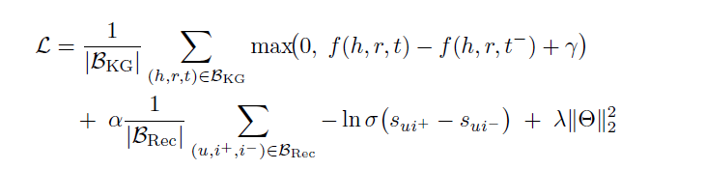
Unified Objective
Single scalar loss: margin‑based KG term + BPR ranking term + ℓ₂ regularization.
Shared parameters across KG and Rec; joint negatives; single backprop step.
Fixed mixing coefficient α; margin γ for KG hinge; dot‑product user–item score.

Slide 8
Data & Graph Construction
MovieLens‑100K with users, items, and enriched side information (genres, directors, actors).
Deterministic alignment to a KG entity space; inverse edges and self‑loops added.
Restrict edges to the interaction universe; standardized parsing via RecBole.

Slide 9
Experimental Setup
Models: BPR, CFKG, CKE, KGCN, ItemKNN, TransE, CompGCN.
Optimization: Adam (lr=1e‑3), early stopping (patience 10).
Dims: 128 for TransE/CompGCN, 64 for others.
CompGCN uses 2 layers and 8 relation bases.
Temporal split; full‑ranking metrics (@10): Recall, Precision, NDCG, MRR.

Slide 10
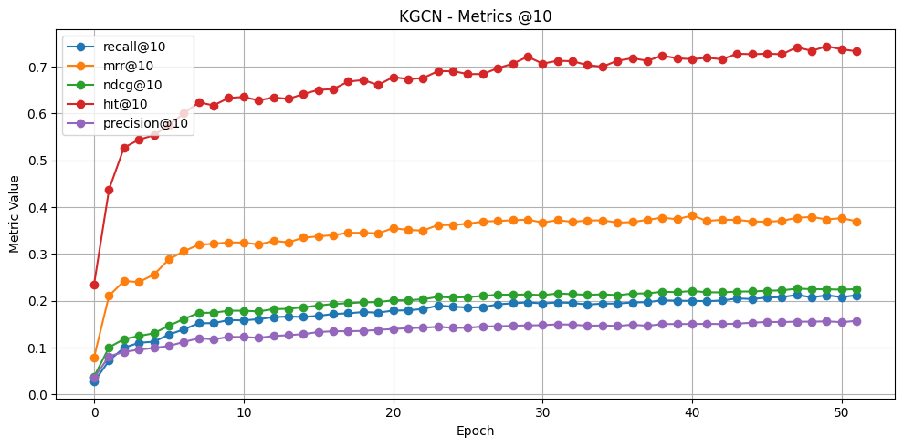

Slide 11
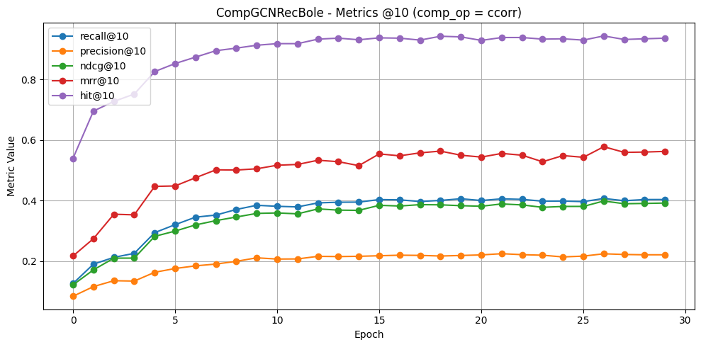

Slide 12
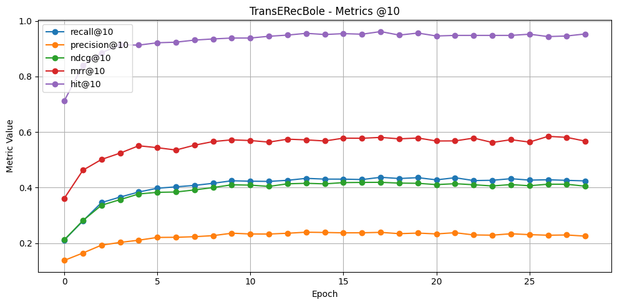

Slide 13
Results
TransE achieves the highest mean score (0.419 at best epoch), leading Recall@10 and NDCG@10.
CompGCN with ccorr is competitive (mean 0.402), outperforming mult and sub variants.
Collaborative baselines (BPR, ItemKNN) and classical knowledge‑aware models (CKE, KGCN) trail in this regime.

Slide 14
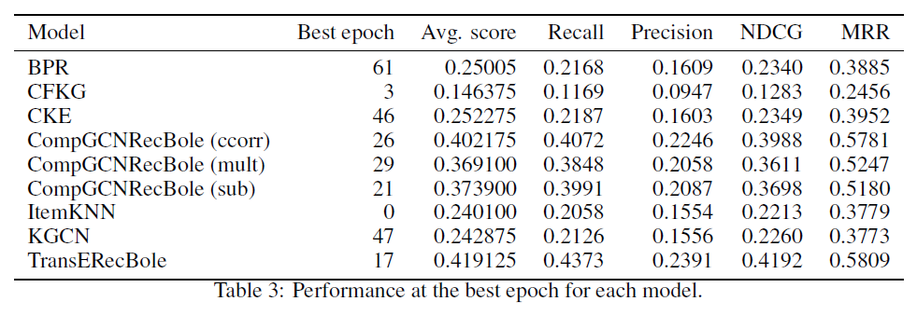
Results

Slide 15
Future works
Future work should
explore dynamic or curriculum-based control of alpha,
investigate hybrid composition mechanisms and attention within multi-relational layers,
assess scalability on larger, heterogeneous knowledge graphs with richer relation vocabularies.

Slide 16
Conclusions
A single objective coupling KG and Rec is compatible with competitive top‑k ranking.
TransE leads in this experimental regime; CompGCN (ccorr) remains close and flexible.
Unified optimization clarifies trade‑offs and simplifies cross‑model comparison.

Slide 17
Thanks for your attention!
Alberto Ricchiuti
Department of Computer Science, University of Bari — Italy
Email: a.ricchiuti20@studenti.uniba.it

